Slide 1
Iowa School Performance Profile (ISPP)
Exploratory Data Analysis Project
Ryan Gilbert
CMP 262-56145

Slide 2
ESSA Background & The Data Set Used
ESSA vs NCLB
Iowa ESSA
2023 Reporting Year - https://www.iaschoolperformance.gov/ECP/Home/Index
Specifications of Data Set - https://www.iaschoolperformance.gov/ECP//Content/files/DatadownloadSpec.pdf

Slide 3
Methodology
Data Exploration
Excel & Jupyter Notebook (Pandas)
Findings - Size of Dataframe, Missing Values, Column Names
Data Cleaning
Jupyter Notebook (Pandas, NumPy)
Reducing Columns (attributes) from 71 to 40
Kept all 1295 rows of Iowa Public Schools
Data Analysis
Jupyter Notebook (Pandas, Matplotlib, Seaborn)

Slide 4
Data Analysis - Question 1
How do schools with a greater percentage of low-socioeconomic status students perform compared to those with a smaller percentage (using FRL as a measure)?

Slide 5
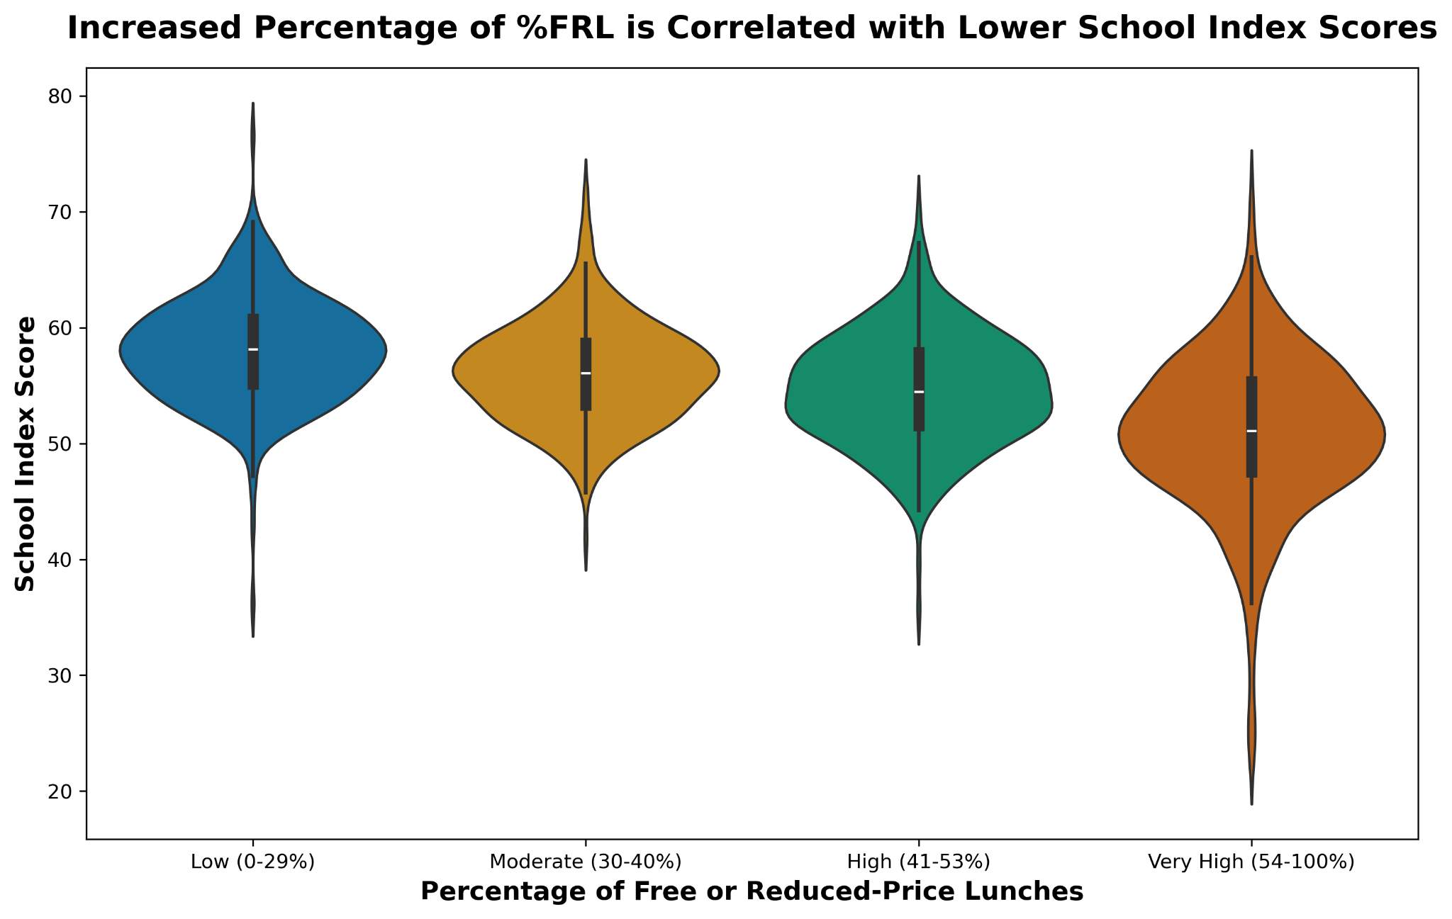
Question 1: Violin Plot

Slide 6
Data Analysis - Question 2
2) How do schools with a greater percentage of students having an IEP Plan perform compared to those with a smaller percentage?

Slide 7
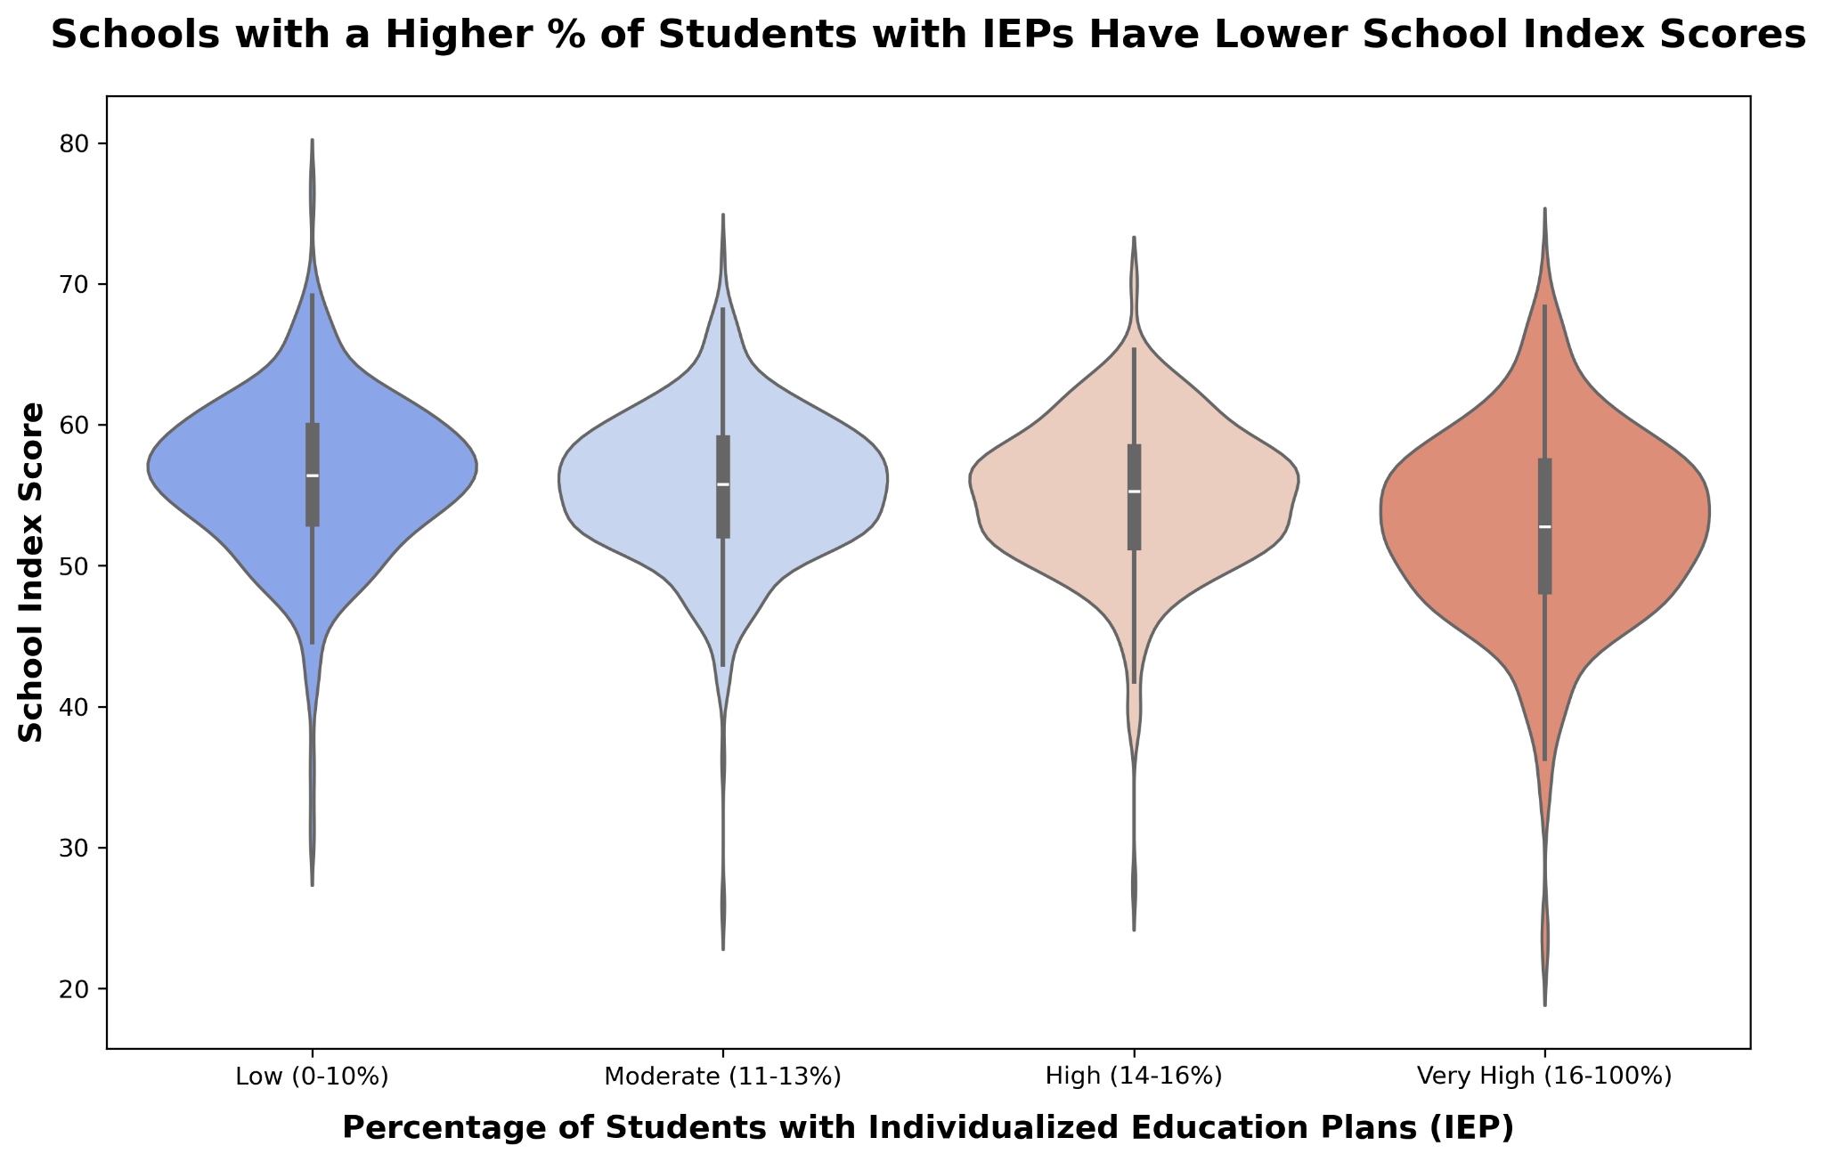
Question 2: Violin Plot

Slide 8
Data Analysis - Question 3
3) What is the distribution of school performance ratings in the state (i.e. “Exceptional”, “Needs Improvement”, etc.)?

Slide 9
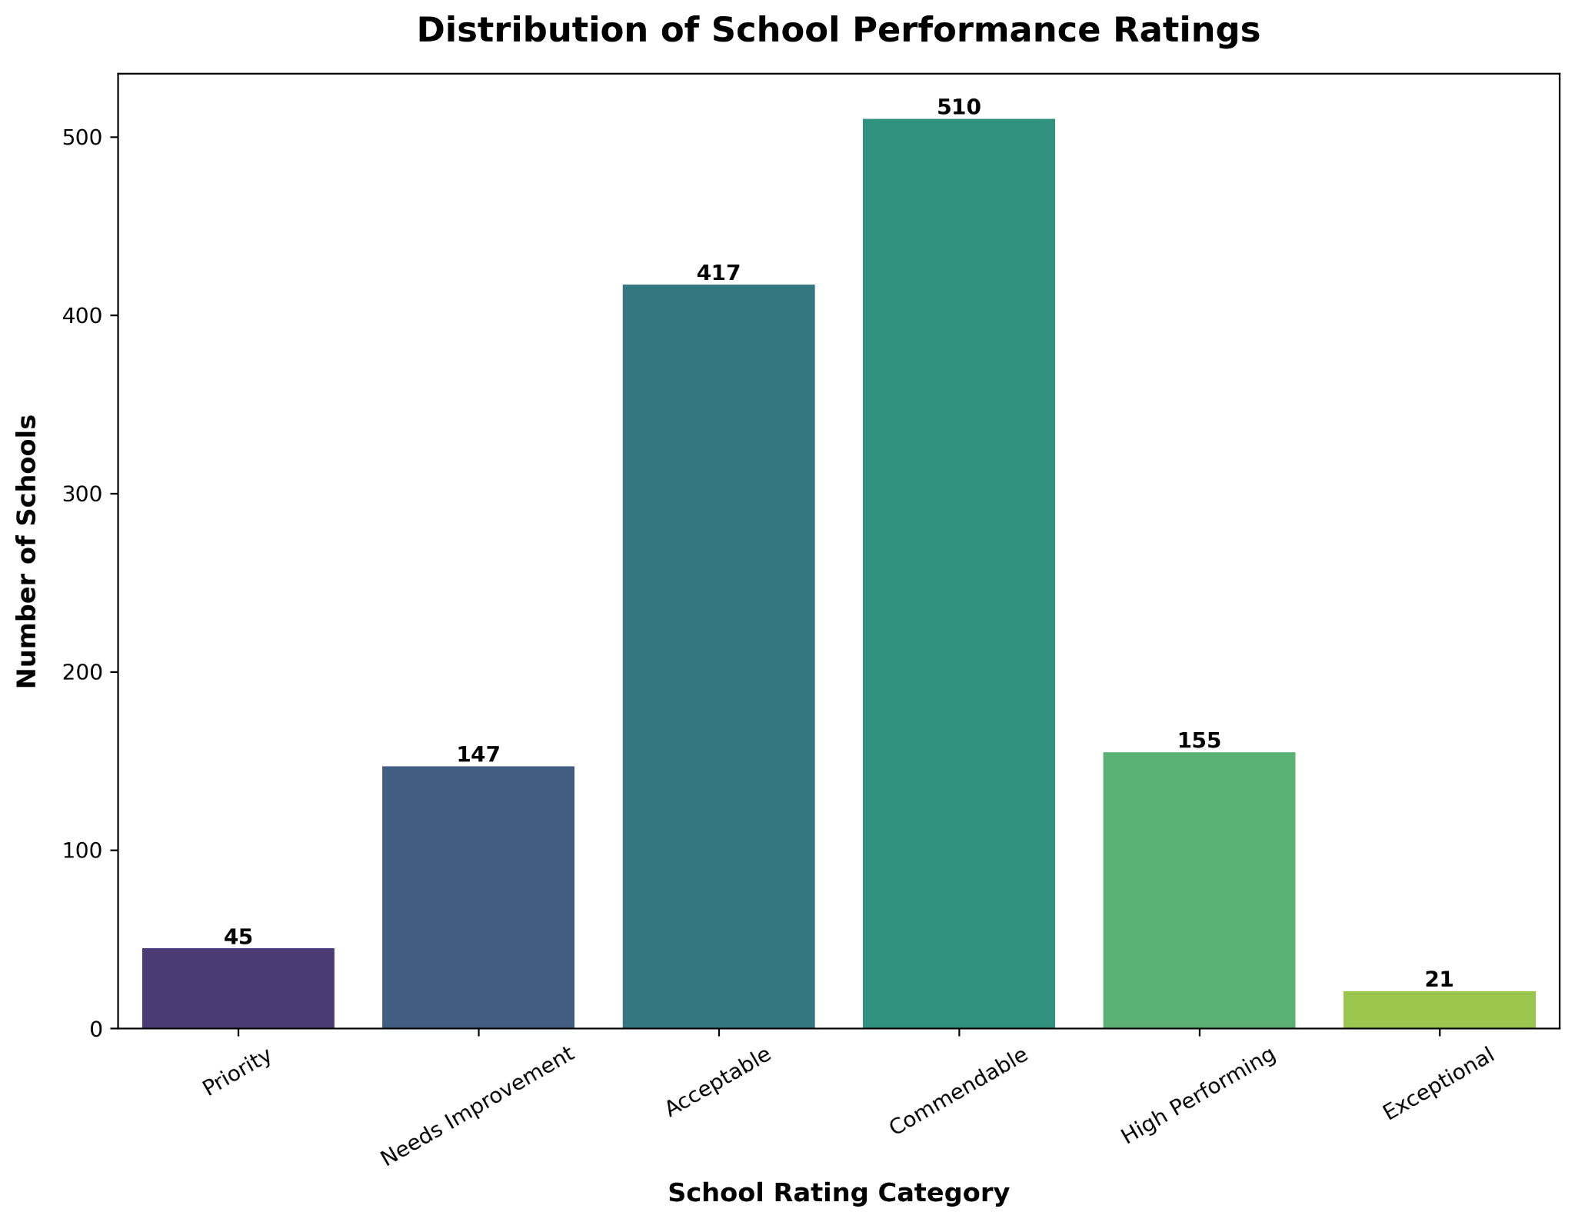
Question 3: Bar Graph

Slide 10
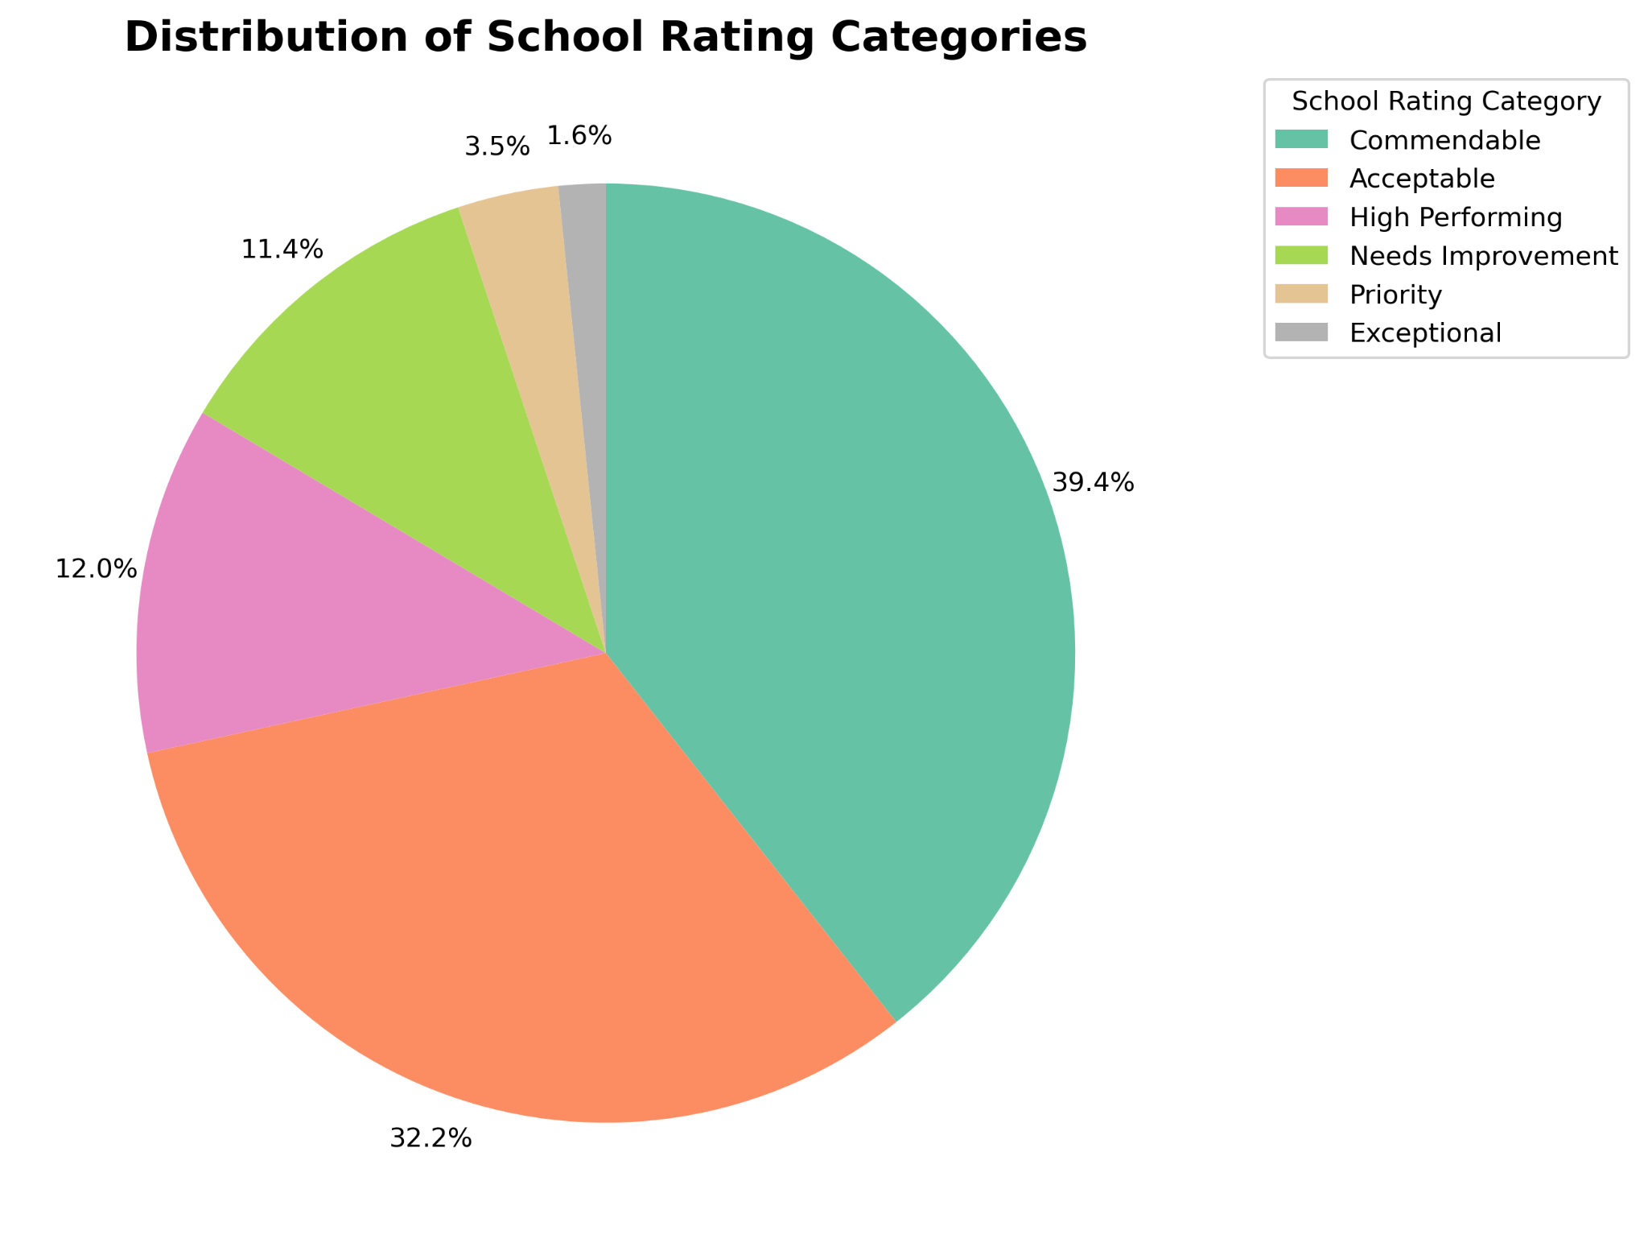
Question 3: Pie Chart

Slide 11
Data Analysis - Question 4
4) Is there variation across school levels (Elementary, Middle, High School) in how they perform while holding School Districts constant?

Slide 12
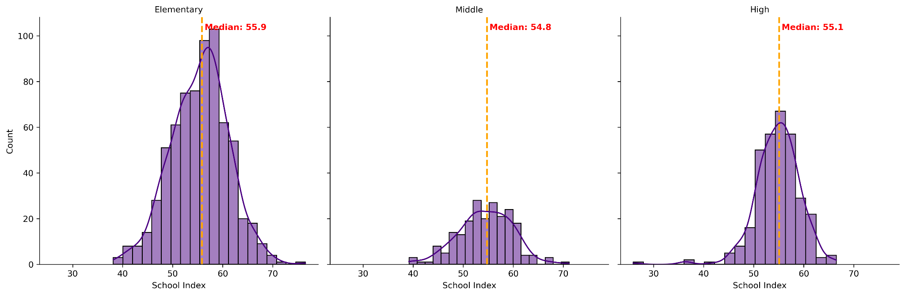
Question 4: Faceted Histogram

Slide 13
Conclusions & Future Studies
Both increased percentage of FRL (Free/Reduced Price Lunch) and IEP are correlated with Lower School Index Scores
%FRL Impact > %IEP
English Learners?
13% Exceeded Expectations, 15% Did not Meet
Percentage of Targeted Schools for Support
Compare to other US States?
No difference among School Levels
District-Level Aid
Granular Differences within Grade Levels and Using Diff. Learning Measures

Slide 14
Works Cited
Institute of Education Sciences. (2023). School performance dataset for selected districts [Data set]. U.S. Department of Education. https://www.iaschoolperformance.gov/ECP/StateDistrictSchool/GetSchoolsDataDownload?DistKeyValues=…&year=2023
Iowa Department of Education. (2024, November). *Iowa School Performance Profiles: Data download file specifications* [PDF]. https://www.iaschoolperformance.gov/ECP/Content/files/DatadownloadSpec.pdf
OpenAI. (2025). ChatGPT [Large language model]. https://chat.openai.com/

